Slide 1
Herramienta para el análisis del rendimiento de la red (y resolución de problemas)
Grupos de Trabajo 2016 - Valencia
miguel.sotos@rediris.es

Slide 2
Arquitectura
mastema.rediris.es
Management
Tests

Slide 3
Arquitectura - Tests
Node to node
Meshed

Slide 4
Cómo lo uso
Pido acceso
RedIRIS proporciona credenciales
Registro los endpoints
Hago los tests
Compruebo los resultados
Repito
¡FACIL!

Slide 5
Métricas
Throughput
As goodput in RFC 2647 – throughput associated with packet payload, ignoring headers
Transaction rate – transactions per second
Response time – seconds per transaction
Lost data – only payload data is included in calculations
Max Lost Burst
Jitter
Delay
MOS – ITU G.107 Mean Opinion Score
Media Delivery Index Calculation
Packet Jitter – individual packets in a media stream
Delay Factor & Media Loss Rate & Media Delivery Index
Notes:
You will have the results based on those metrics, which the user can consult, and also the user can configure the limits based on those metrics that will make a tests to pass or to fail

Slide 6
Tipos de tests – node to node y mesh
UDP/TCP throughput
Bitrate
KPIs
Loss/jitter/latency
QoS level 3
Voice and Video – using different codecs, simulating transmissions
Response time
TCP, http/https, pop3/stmp, FTP, DNS, Exchange 365 and SIP

Slide 7
Tipos de tests – real service test
HTTP
Avaliability and download time
FTP
Download time
DNS
Query
TCP/UDP ping and Traceroute
Bittorrent
Dropbox
Email
Youtube
IGMP
From OVA or harware endpoints

Slide 8
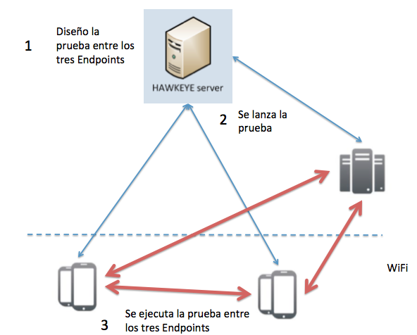
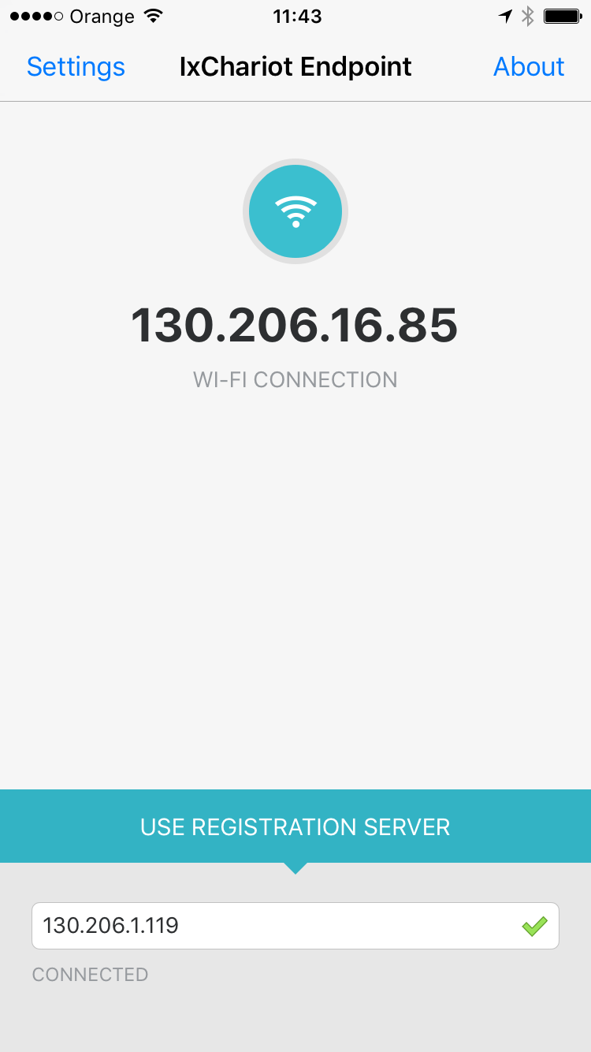
Caso de uso

Slide 9
Restricciones

Slide 10
MAS INFORMACION
http://www.rediris.es/conectividad/rendimiento.html

